Slide 1

Rails Girls Galway
Deploying in the Azure Cloud
@gerryk

Slide 2
who am i?
* Application Developer
* Linux System Administrator
* Web & WebApp Developer
* Free Open Source Advocate
* Telecoms Consultant
* Information Security Analyst
* Telecoms Platform Architect

Slide 3
prep
If on a Windows Development box…
Download and install RailsInstaller
http://www.chiark.greenend.org.uk/~sgtatham/putty/download.html
Download and install Putty and Pscp
http://railsinstaller.org/en
Create your app!

Slide 4
create an azure account
Navigate to http://azure.com/
Select Try it for free!
You may need to create an MS account if you do not have one

Slide 5
create an azure vm
From the Azure Portal…
Select Virtual Machines
Click New +
Select From Gallery
Select Ubuntu 12.04 LTS
Click Next ->

Slide 6
create an azure vm
Fill in the details…
Give the VM a name
Choose a size (A0 or A1)
Choose a username
Authentication type: password
Click Next ->

Slide 7
create an azure vm
Fill in the details…
Cloud Service: Create New
Choose Cloud Service DNS Name
Choose a Region
Storage Account: Autogenerated
Availability Set: None
Endpoints: leave as default
Click Next ->

Slide 8
set up the azure vm
ssh to the DNS name created
log in with the details created
Execute the following…
$ sudo apt-get update -y
$ sudo apt-get upgrade -y
$ sudo apt-get install ruby1.9.1 ruby1.9.1-dev build-essential libsqlite3-dev nodejs -y
$ ruby -v
ruby 1.9.3p545 (2014-02-24) [i386-mingw32]
$ sudo gem install bundler --no-rdoc --no-ri

Slide 9
copy over your app
If Linux or OSX Execute the following…
If Windows, Execute the following…
$ scp -r app_directory user@server.cloudapp.net:
$ scp -r app_directory user@server.cloudapp.net:
$ pscp.exe -r app_directory user@server.cloudapp.net:

Slide 10
oh, you want to use github?
First… On your local machine, push your project
Then, on your cloud instance, pull the repo...
$ scp -r app_directory user@server.cloudapp.net:
$ git remote add github https://github.com/MYUSER/MYREPO
$ git push -u github master
$ git clone https://github.com/MYUSER/MYREPO

Slide 11
prepare the app
Execute the following…
$ cd ~/app_directory
$ bundle install
$ rake db:migrate
$ rails s
=> Booting WEBrick
=> Rails 4.1.1 application starting in development on http://0.0.0.0:3000
=> Run `rails server -h` for more startup options
=> Notice: server is listening on all interfaces (0.0.0.0). Consider using 127.0.0.1 (--binding option)
=> Ctrl-C to shutdown server
[2014-06-20 12:57:45] INFO WEBrick 1.3.1
[2014-06-20 12:57:45] INFO ruby 1.9.3 (2011-10-30) [x86_64-linux]
[2014-06-20 12:57:45] INFO WEBrick::HTTPServer#start: pid=9014 port=3000

Slide 12
configure an endpoint
From the Azure Portal…
Select your active VM
Select Endpoints
Click New +
Enter details as follows…

Slide 13
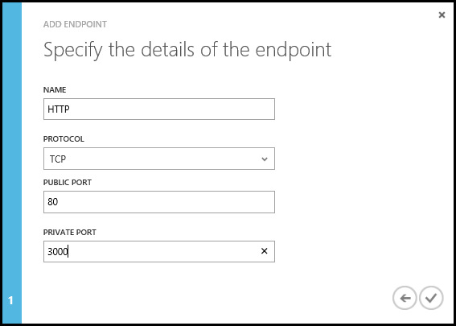
configure an endpoint

Slide 14
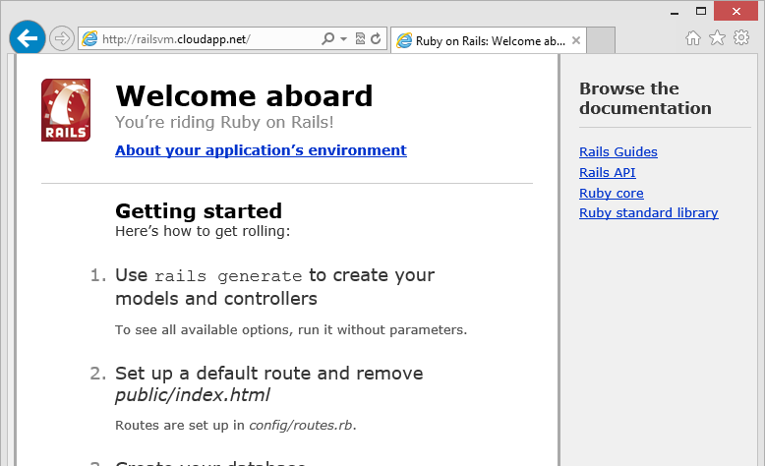
navigate to your app

Slide 15
how to find me
@gerryk
github.com/gerryk
launchpad.net/~gerryk

